Slide 1






2025.03
25-1
AI Tutorial
CATS
-01 Neural Network-
Presenter. Kim Chanu

Slide 2



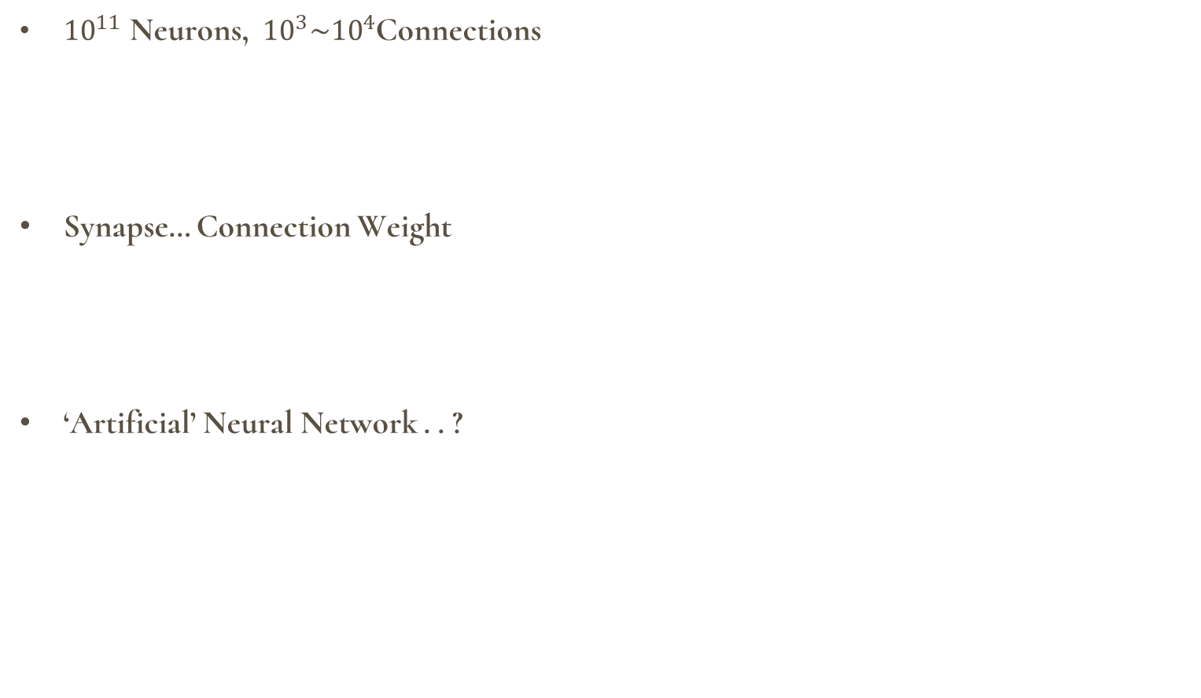
Chapter 01
2025.03
Neuron
Neural Network
${10}^{11}$ Neurons, ${ 10}^{3}\sim {10}^{4}$Connections
Synapse… Connection Weight
‘Artificial’ Neural Network . . ?
CATS
Neuron

Slide 3
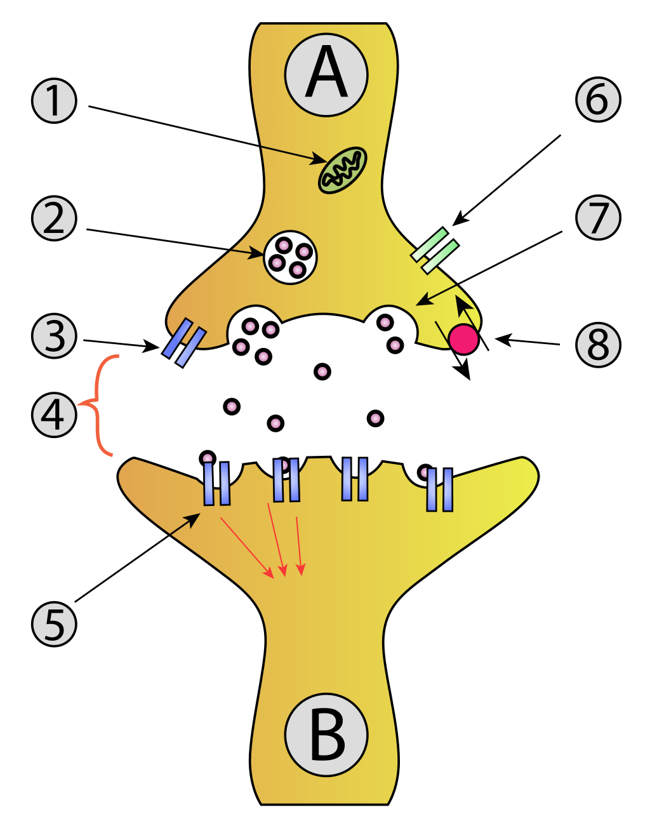
Chapter 01
2025.03
Synapse
Neural Network
${10}^{11}$ Neurons, ${ 10}^{3}\sim {10}^{4}$Connections
Synapse… Connection Weight
‘Artificial’ Neural Network . . ?
CATS
Synapse

Slide 4
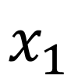
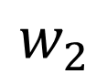
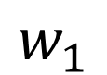
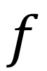
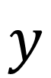

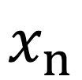
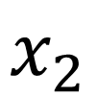
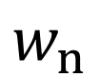
Chapter 01
2025.03
Perceptron
Neural Network
$$x_{1}$$
$$w_{1}$$
$$x_{2}$$
$$w_{2}$$
CATS
$$.$$
.
.
$$f$$
$$y$$
$$w_{n}$$
Perceptron
$$x_{n}$$

Slide 5
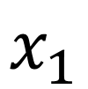
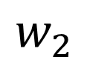
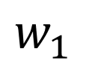
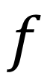

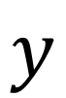
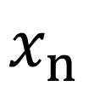
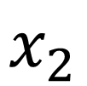
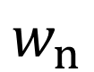
Chapter 01
2025.03
Neural Network = Perceptron + ‘s’
Neural Network
$$x_{1}$$
Scaling Factor
Summation
Threshold
$$w_{1}$$
$$x_{2}$$
$$w_{2}$$
CATS
$$.$$
.
.
$$f$$
$$y$$
$$w_{n}$$
Perceptron
$$x_{n}$$

Slide 6
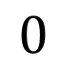
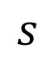
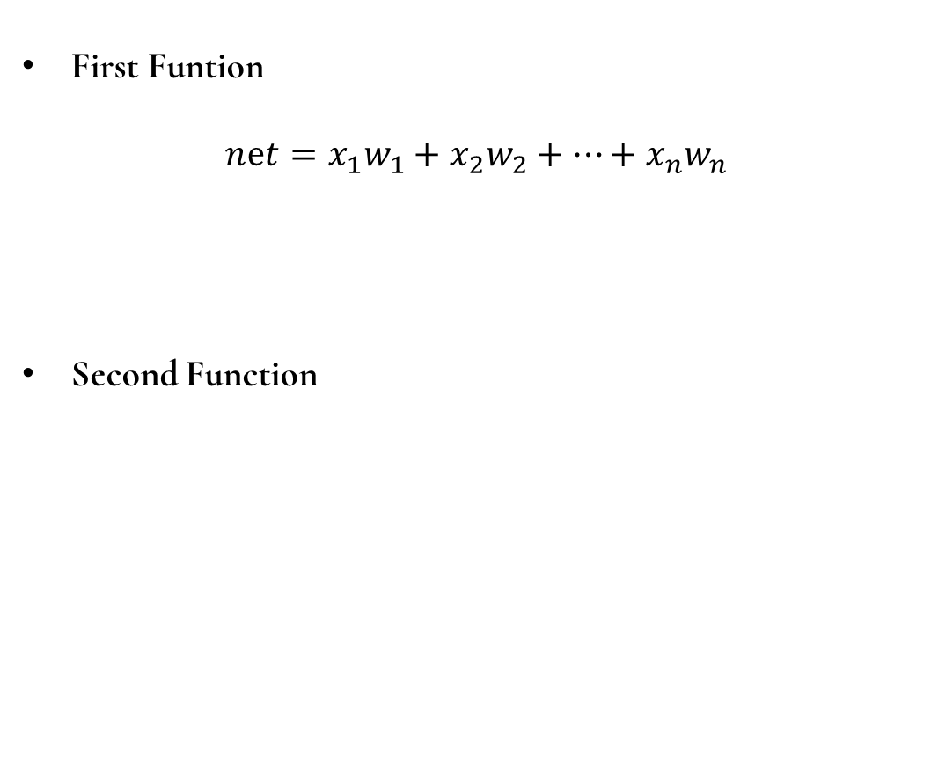
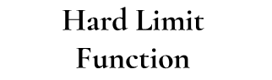

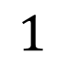
Chapter 01
2025.03
Perceptron’s Function
Neural Network
$$x_{1}$$
$\text{First} \text{Funtion}$
$$nⅇt=x_{1}w_{1}+x_{2}w_{2}+⋯+x_{n}w_{n}$$
Second Function
$$w_{1}$$
$$x_{2}$$
$$w_{2}$$
CATS
$$.$$
.
.
$$f$$
$$y$$
$$w_{n}$$
Perceptron
$$\text{Hard} \text{Limit}$$
$\text{Function}$
$$x_{n}$$
$$1$$
$$s$$
$$0$$

Slide 7
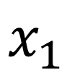
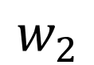
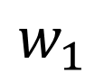
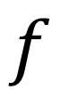

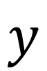
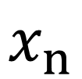
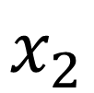
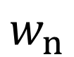
Chapter 06
2025.03
Neural Network
Strategy
$$x_{1}$$
$$w_{1}$$
CATS
$$x_{2}$$
$$w_{2}$$
$$.$$
.
.
$$f$$
$$y$$
$$w_{n}$$
Perceptron
$$x_{n}$$

Slide 8
2025.03
Thank You!
CATS
Presenter
Kim Chanu

